Slide 1


Optimizing Kalman Filter for Target Tracking using Fixed Wing UAVs
Simon Li, Zixi Liu, Michelle Zhang

Slide 2
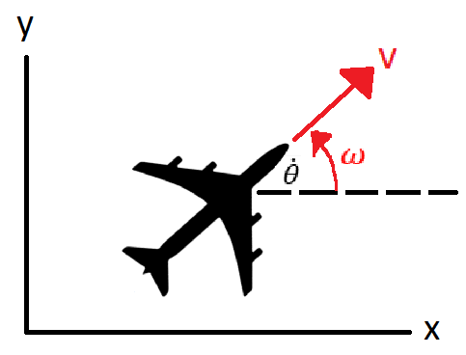





Background and Problem Formulation
Search and Rescue, emergency response mission using UAVs.
Fixed wing UAVs for improved search area coverage
Accurate measurements of aircraft position
Noisy, distance only measurements of distress beacon
Goal: Determine the trajectory that will reduce beacon location estimation uncertainty in least time using EKF, with constant altitude flight.
Aircraft Model Measurement and Sensor Model

Slide 3
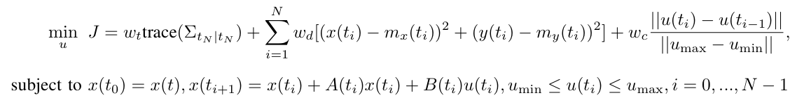

Model Predictive Control (MPC) Optimization
Note that

Slide 4
Model Predictive Control (MPC) Optimization
Measurement Quality
Note that

Slide 5
Model Predictive Control (MPC) Optimization
Measurement Quality
Distance to Beacon
Note that

Slide 6
Model Predictive Control (MPC) Optimization
Measurement Quality
Distance to Beacon
Control Efforts
Note that

Slide 7
Model Predictive Control (MPC) Optimization
Measurement Quality
Distance to Beacon
Control Efforts
Note that
Procedure:
Estimate current state (mean) and covariance at t
Compute optimal open-loop controls based on Kalman predictor to horizon N, perform update on covariance at each expected measurement time step.
Repeat

Slide 8
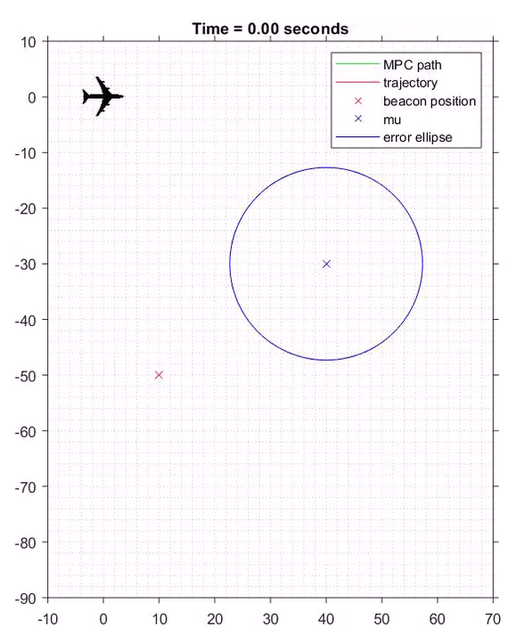
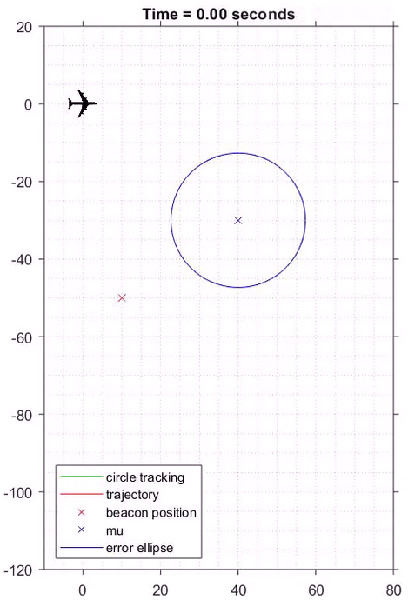
MPC Results Circular Track Results

Slide 9
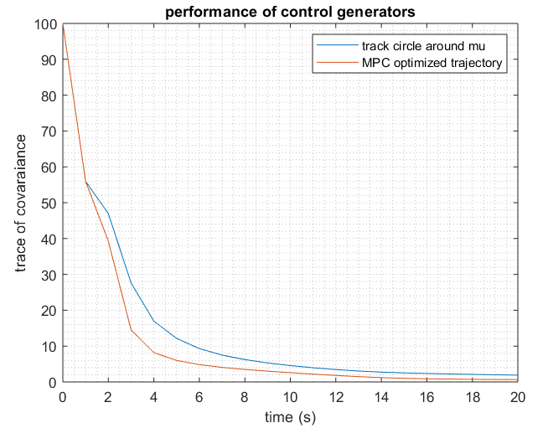
Filter Performance

Slide 10
Thank you!

